Slide 1
Who am I?
Between each round, you will be shown a picture that is in some way linked to someone famous. Can you guess who? You may submit an answer after each picture is shown. The sooner you guess correctly, the more you will score.

Slide 2
Early clues will (hopefully) be tricky
You may have to think laterally (clues may not be immediately obvious)
Each subsequent clue should make it more likely that you can identify the person
Each clue will appear during the break between rounds and will NOT be shown again

Slide 3
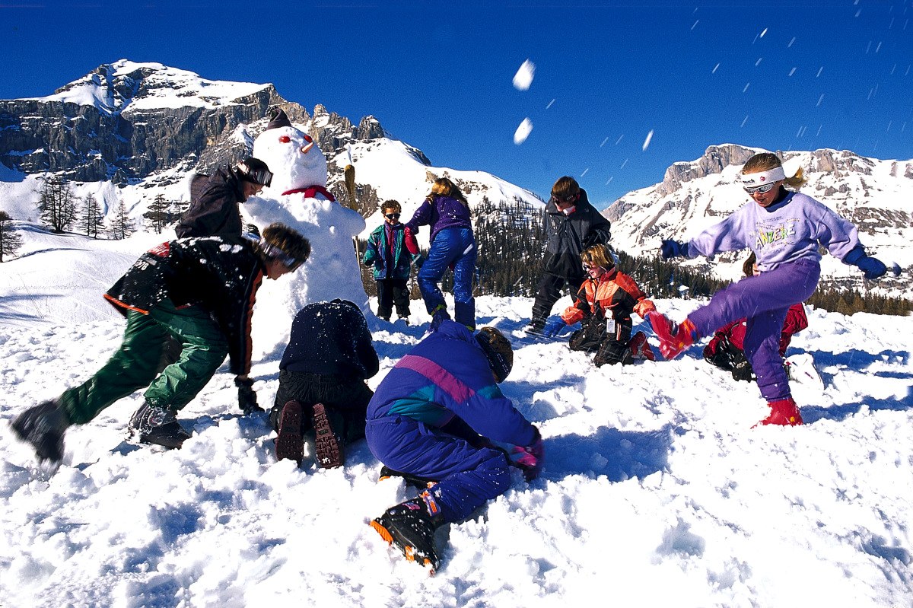
Who am I? 1 (10 points)

Slide 4
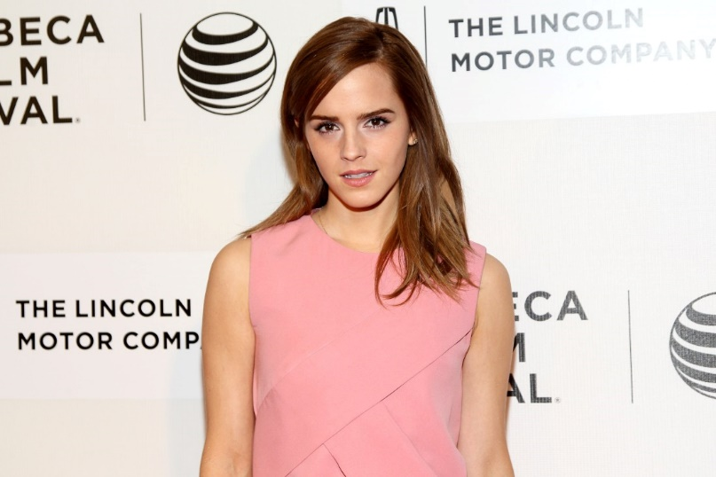
Who am I? (9 points)

Slide 5

Who am I?

Slide 6

Who am I?

Slide 7
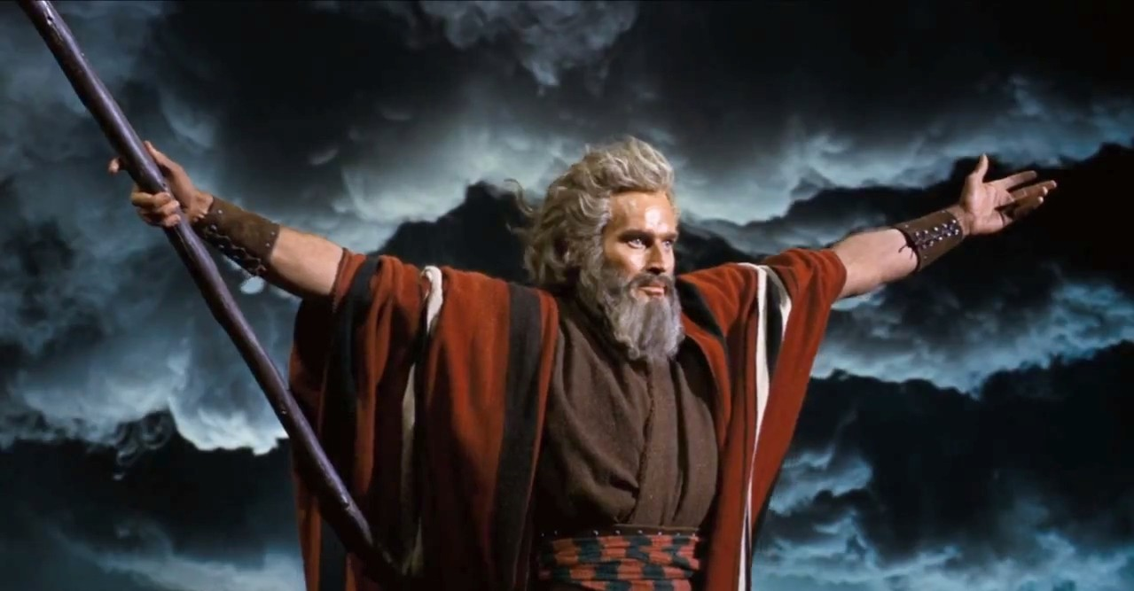
Who am I?

Slide 8
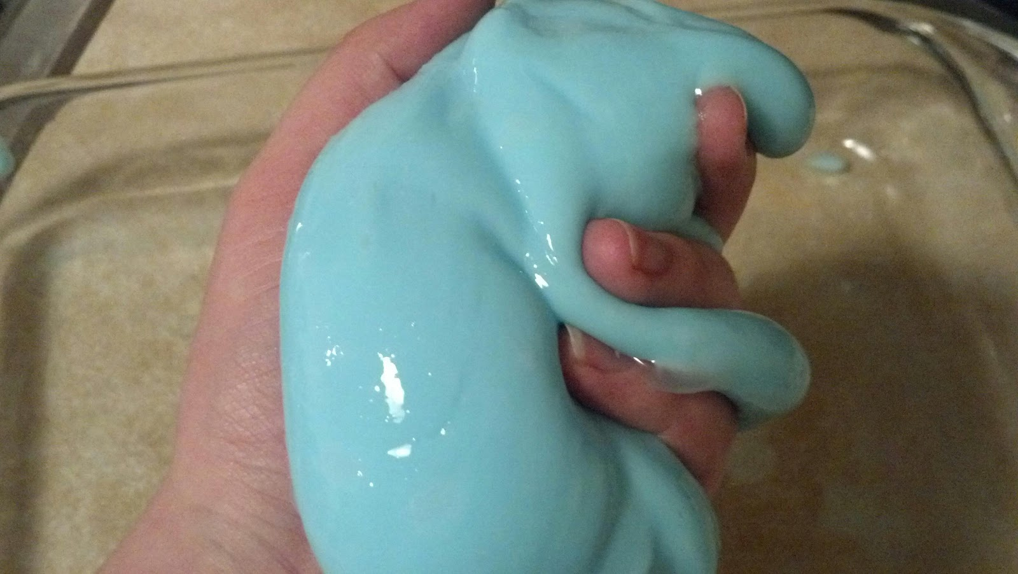
Who am I?

Slide 9

Who am I?

Slide 10

Who am I?

Slide 11

Who am I?

Slide 12
